Slide 1

Frito Lay Attrition Case Study
Renu Karthikeyan

Slide 2
Statement of Purpose
The purpose of this study is to understand the factors influencing employee attrition from the workforce data at Frito Lay, develop predictive models for attrition risk, and evaluate the performance of the predictive models.

Slide 3
Exploratory Data Analysis

Slide 4
Full Data Set of All Employees Analysis

Slide 5
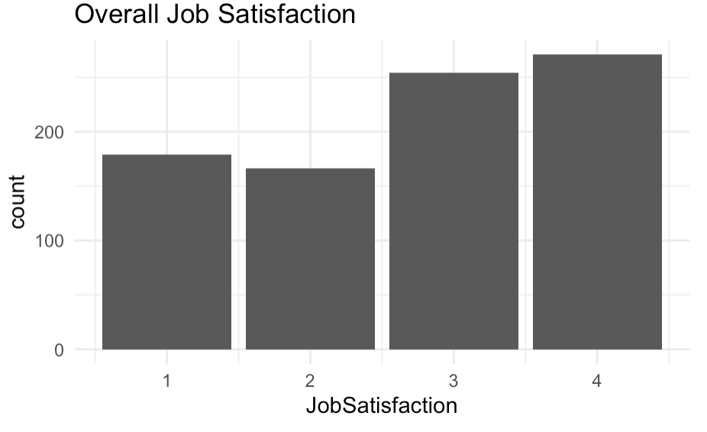
Overall Job Satisfaction
Notes:
Here, we look at overall Job Satisfaction among the employees. It looks like majority of employees seem to be satisfied with their job, with a handful not being as satisfied. It is a left skewed histogram.

Slide 6
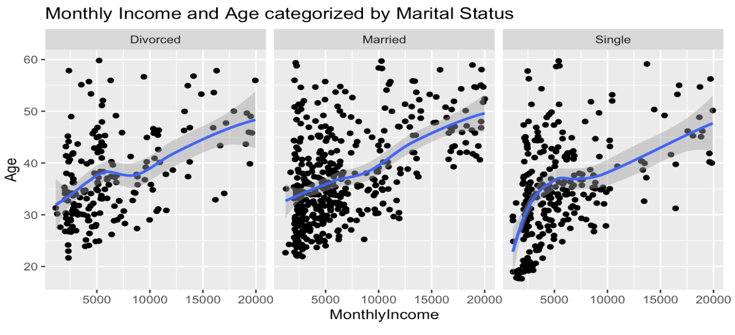
Monthly Income and Age Categorized by Marital Status
Notes:
Here, we see Monthly Income by Age categorized by Marital Status. Starting off, it looks like Divorced and Married people tend to make more as their age increases. However, the same positive trend is seen for Single people, but they do not make as much as their Married or Divorced coworkers. But there is definitely a positive trend between age and monthly income.

Slide 7
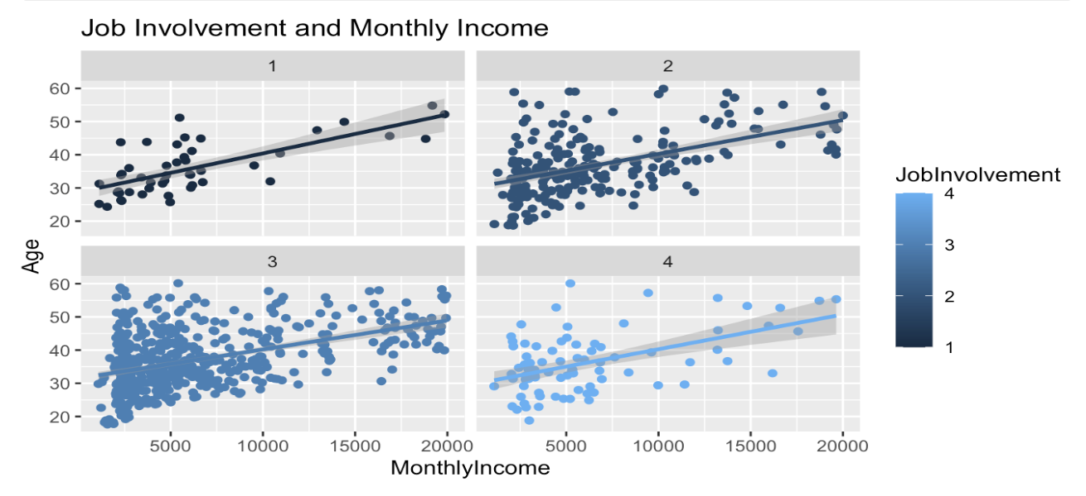
Job Involvement and Monthly Income
Notes:
Looking at job involvement and monthly Income, it looks most employees regardless of Job Involvement have a positive correlation between Age and Monthly Income. I was trying to see if those who were more involved in their job made a higher income, but that does not seem to be the case at first glance. It looks like a lot of employees are pretty involved in their jobs (Job Involvement levels 2 and 3).

Slide 8
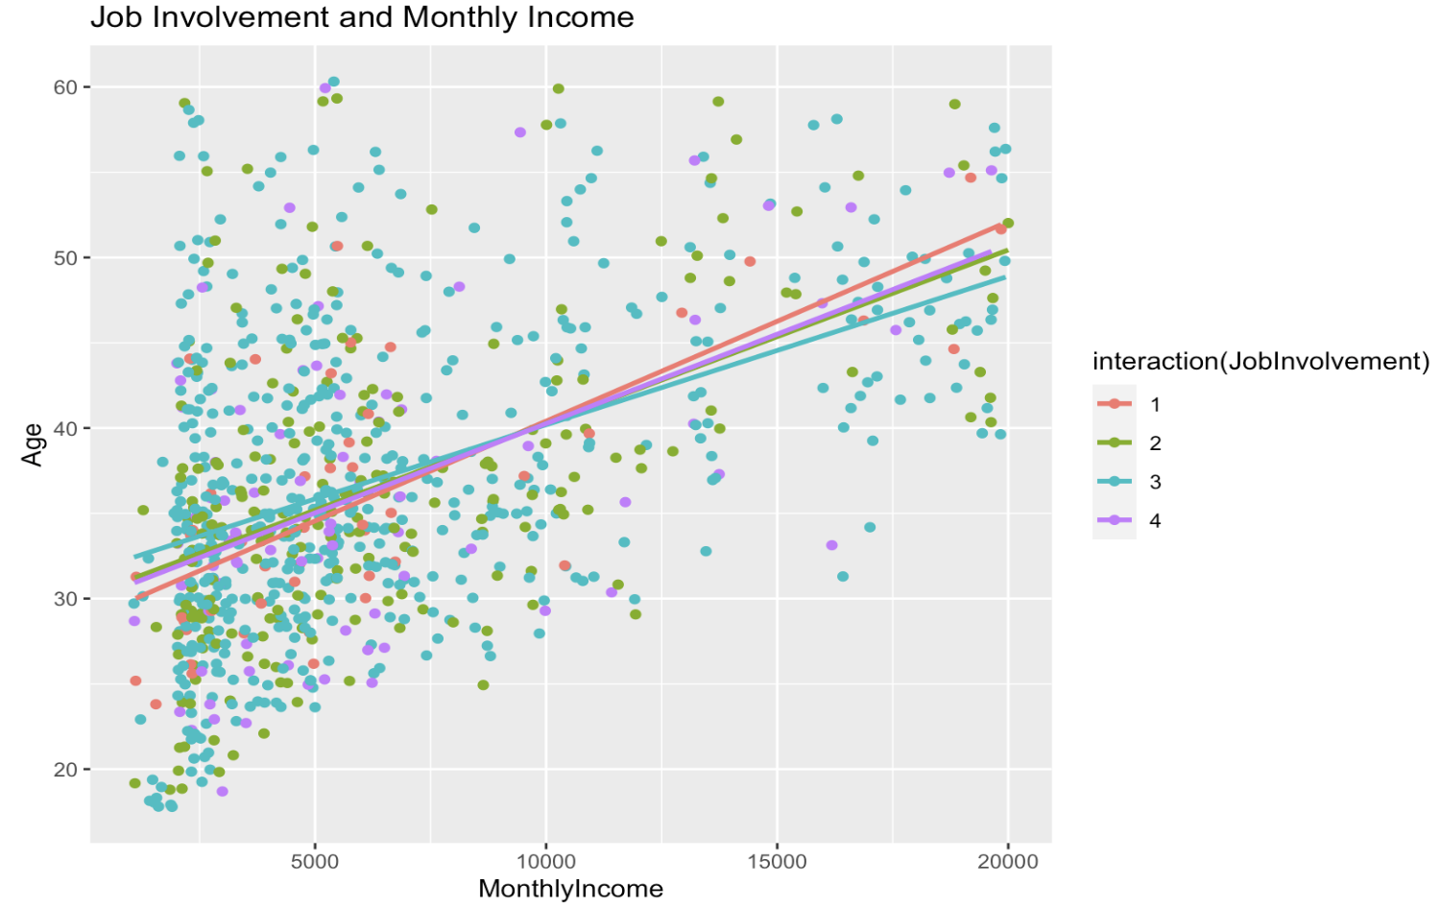
Job Involvement and Monthly Income
Notes:
When I plotted all 4 job levels with their respective linear regression lines, it looks like those with least job involvement (Job Involvement 1) start to make more after crossing 40 years old and a monthly income of 10,000. It seems like Job Involvement 3 make the most starting off up to a monthly income of 10,000 and ~40 years old, and start to make the least as they near 50 years old. Job Involvements 2 and 4 linear regression lines fall in between the 1 and 4 lines initially and towards the end, they are very close to each otehr, and seem to overlap.

Slide 9
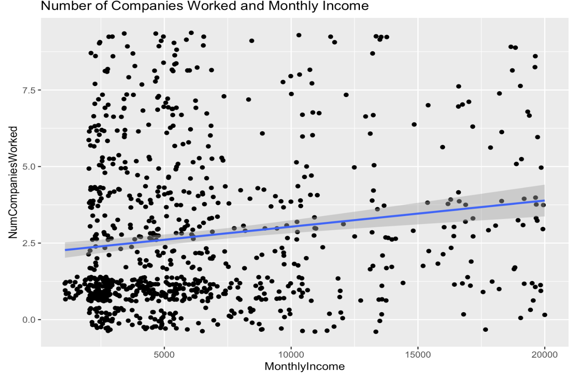
Number of Companies Worked and Monthly Income
Notes:
There is positive correlation between Monthly Income and Number of Companies worked.

Slide 10
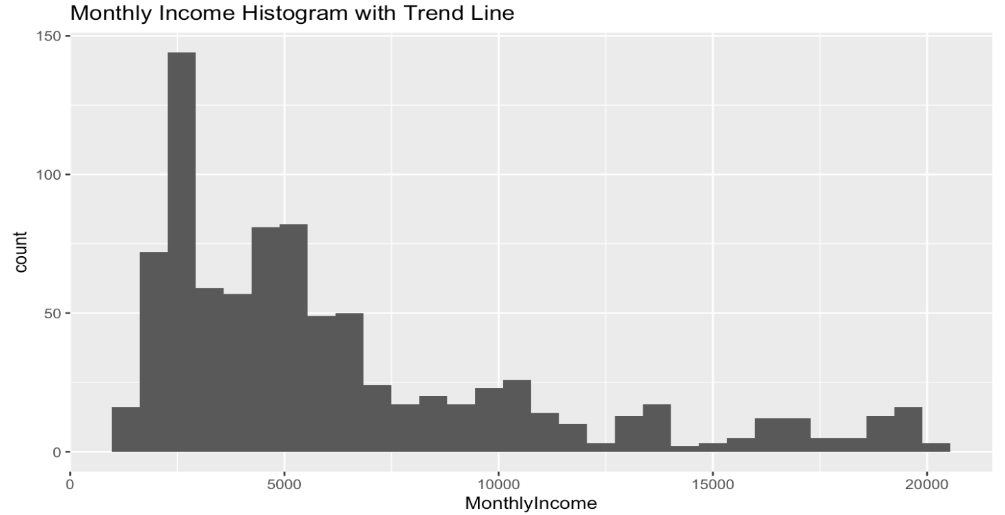
Histogram of Monthly Income
Notes:
Looking at a histogram of Monthly Income, it looks to be right skewed. The mode is less than the median which is less than the mean.

Slide 11
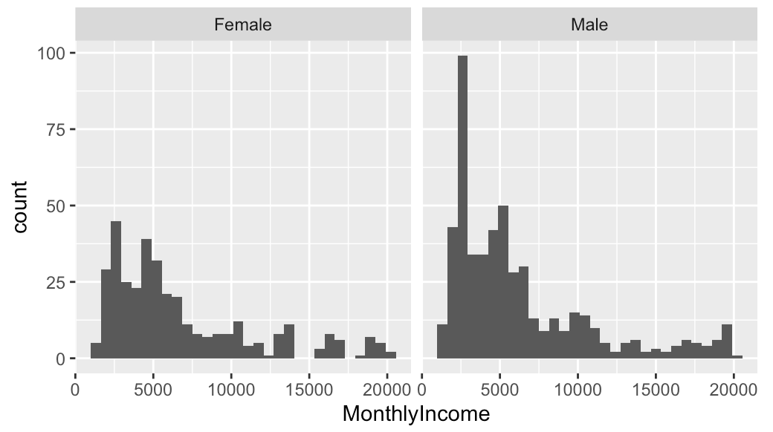
Histogram of Monthly Income Categorized by Gender
Notes:
Looking at monthly income categorized by Gender, it looks like there are more male datapoints in the dataset than femalses. The mode is higher for men than it is for women. Both histograms are right skewed.

Slide 12
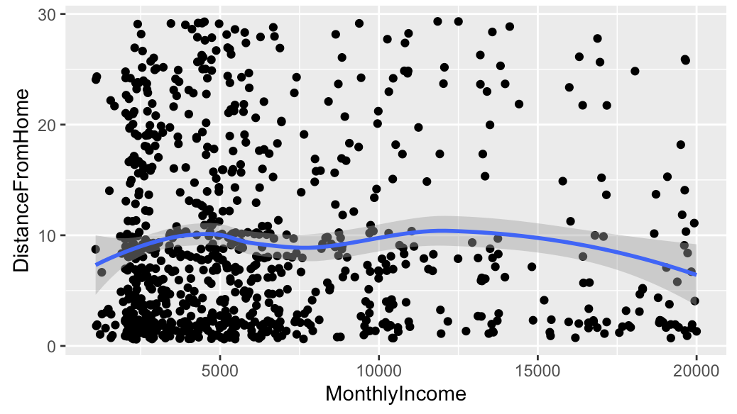
Monthly Income and Distance from Home
Notes:
There seems to be a negative correlation between distance from home and monthly income. The plot and loess curve imply that as distance from home initially increases, monthly income also increases, but after a monthly income of 15,000 is exceeded, there is an overall decrease in the distance from home. The curve resemebles a concave curve, with the downward slight 'w' shape. Looking at this graph, I would interpret distance from home to be in miles, because if this is in kilometers, it doesn't seem to make logical sense.

Slide 13
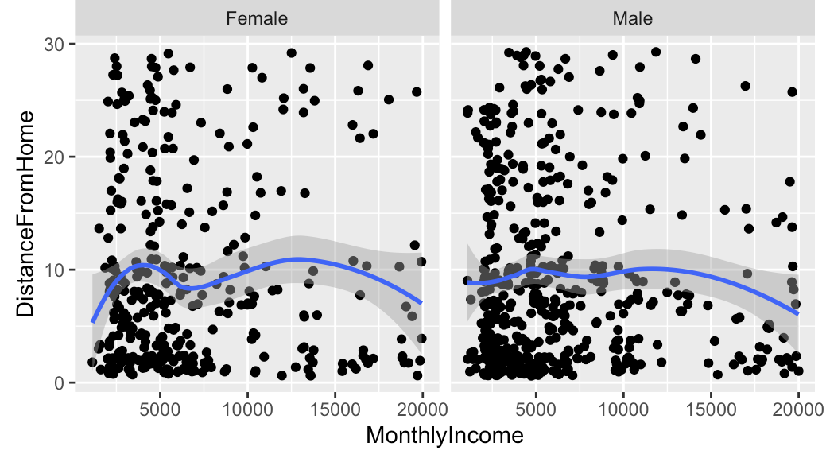
Monthly Income and Distance from Home Categorized by Gender
Notes:
There seems to be a more prominent downturned 'w' shape for women than for men. But the overall relationship is as mentioned above (between distance from home and Monthly Income).

Slide 14
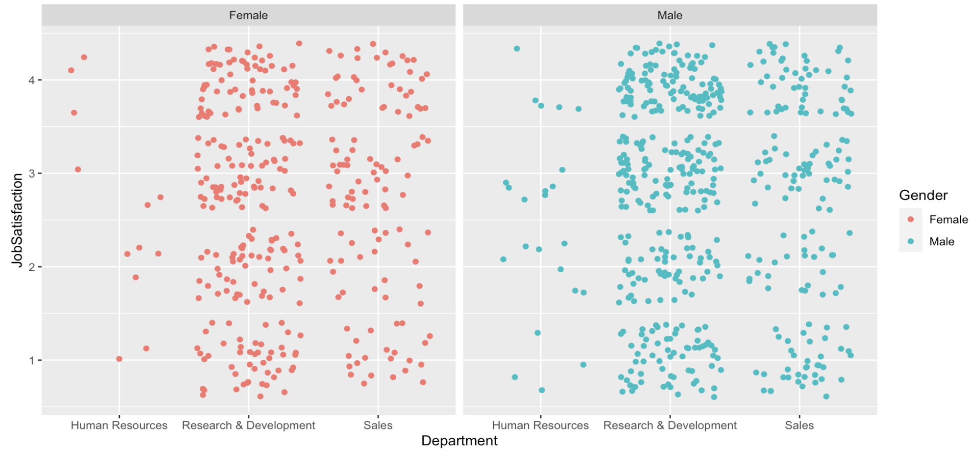
Department and Job Satisfaction by Gender
Notes:
Job Satisfaction seems to be higher for Research and Development for both Males and Females. There are less data points for those in Human Resources so a clear defined relationship can't be concluded. There seems to be decent job satisfaction for those in Sales too for both genders.

Slide 15
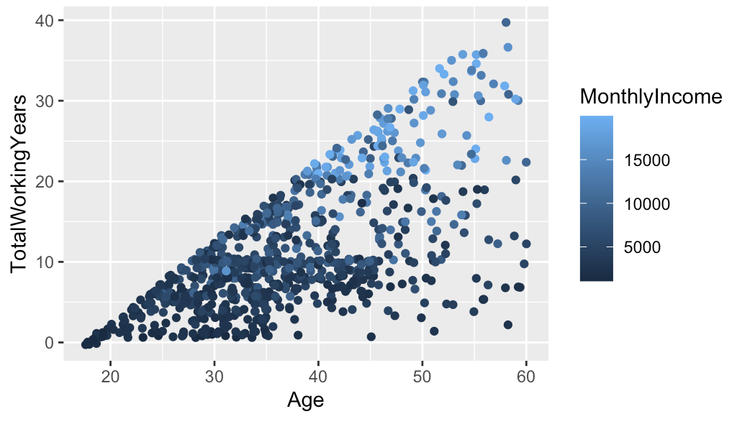
Age and Total Working Years with Monthly Income
Notes:
This plot confirms that as Age increases, total working years also increase, and monthly income seems to follow the same trend as well. There is a positive correlation between all 3 variables - Age, Total working years, and monthly income.

Slide 16
Attrition Specific Analysis
Notes:
Here, we are looking the employees who attrited

Slide 17
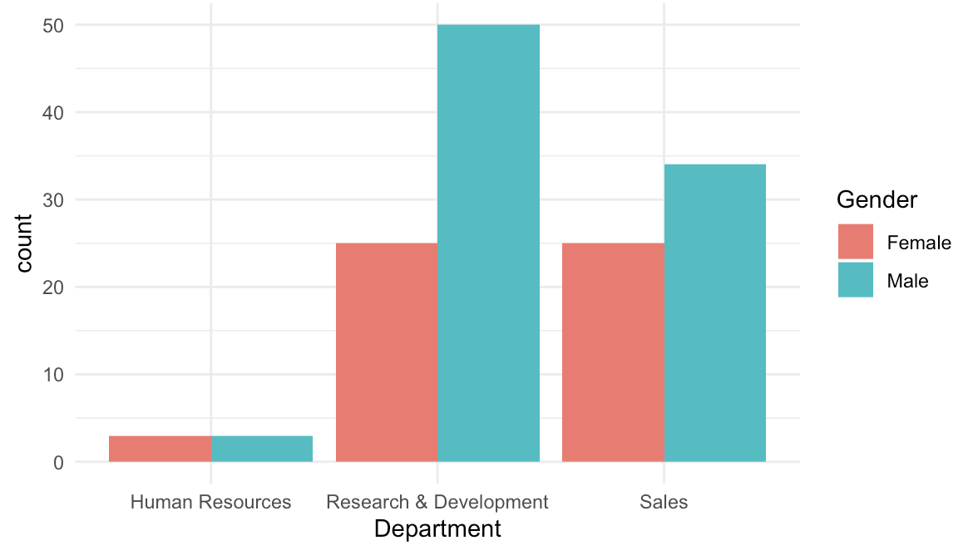
Attrition by Department and Gender
Notes:
Of those who left the company, many men were in Research & Development and Sales, while there were equal amounts of women in Research & Development and Sales. There are equal amounts of men and women from Human resources who left the company.

Slide 18
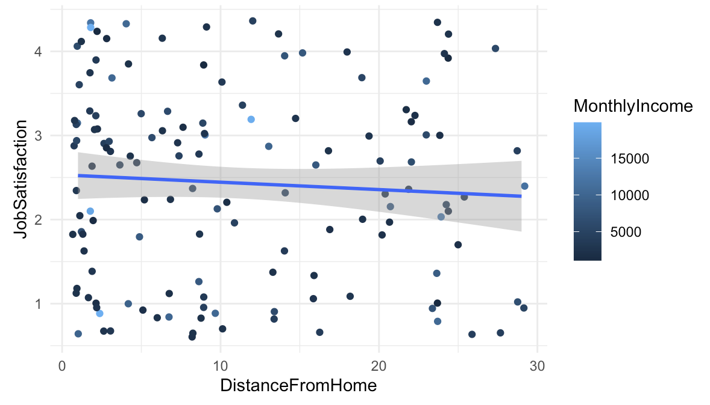
Attrition - Distance from Home, Job Satisfaction with Monthly Income
Notes:
Of those who left the company, it seems likes a lot of them were making under $10,000 monthly. There seems to be a negative relationship between Job Satisfaction and Distance from home (as distance from home increases in miles, the job satisfaction goes down).

Slide 19
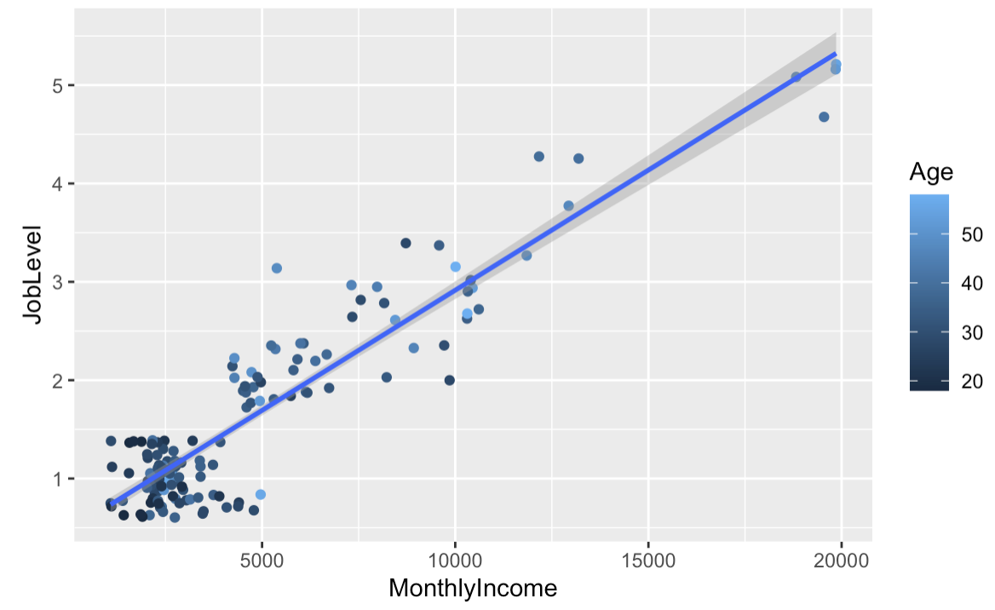
Attrition - Monthly Income and Job Level with Age
Notes:
Of those who left the company, there is a positive relationship between job level and Monthly income. Age seems to be scattered, but at a job level of around 1, and monthly income less than 5000, the age group seems to have employees in their 20s.

Slide 20
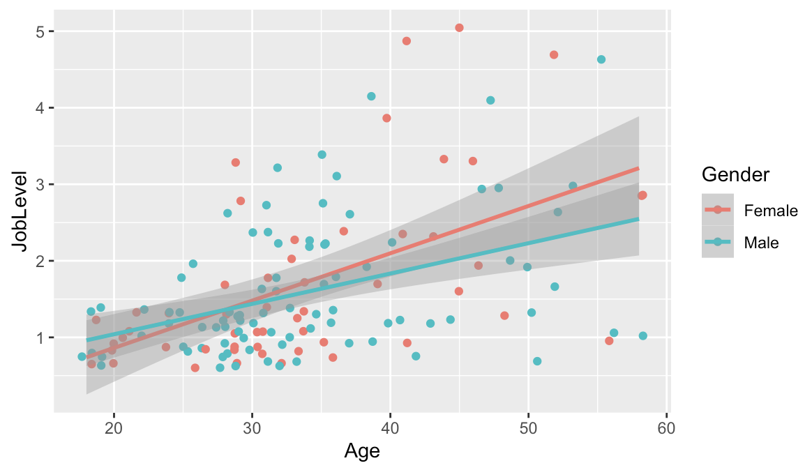
Attrition - Job Level by Age and Gender
Notes:
OF those who left the company, it looks like Job Level is positively correlated with Age for both Males and Females. The slope of the linear regression line for females seems to be more steep than it is for the males.

Slide 21
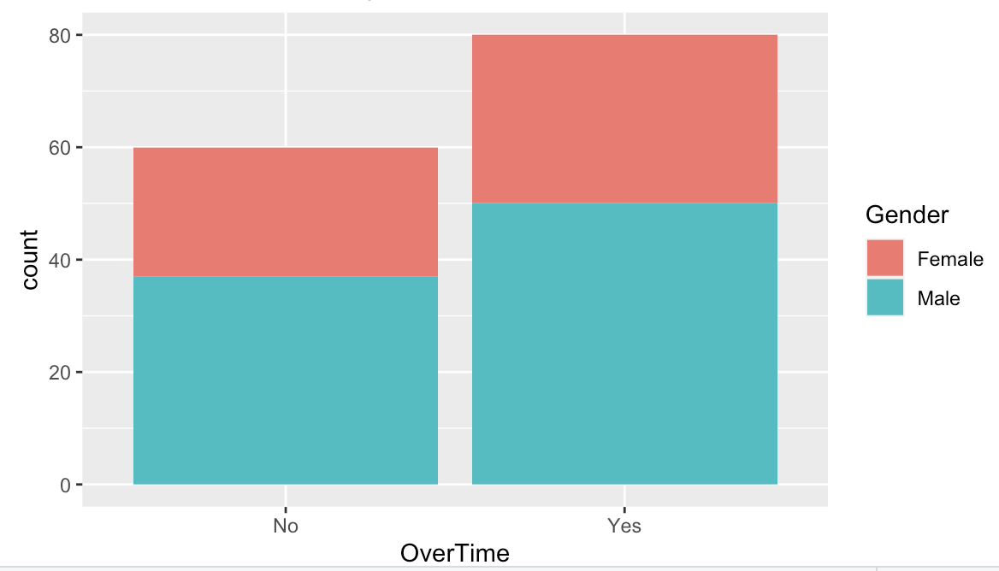
Attrition – Overtime by Gender
Notes:
Of those who left the company, many employees were working over time. As mentioned earlier, there are more male data points compared to females, which is why at first glance it may seem a bit off. It looks like of the Over time group - approximately 70% were males, and 30% was females.

Slide 22
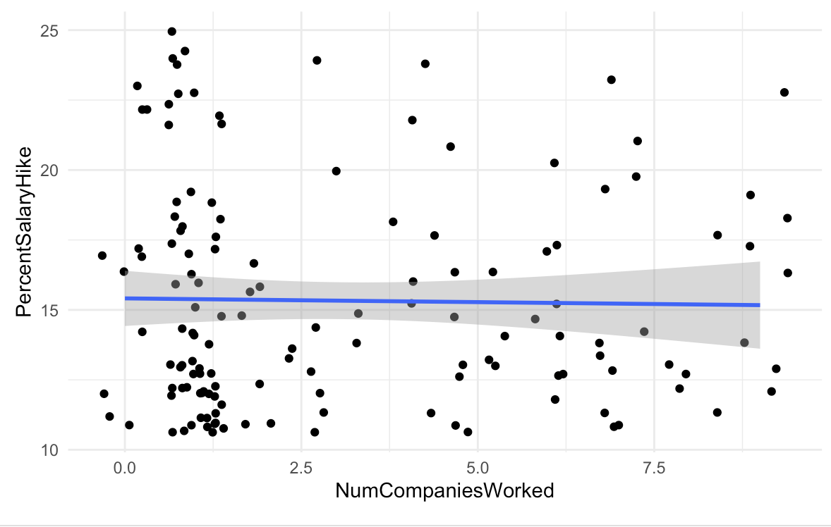
Attrition - Percent Salary Hike and Number of Companies Worked
Notes:
There seems to be a slight downward trend when looking at the relationship between Number of companies worked and Percent salary hike. I was trying to see if the number of companies worked affected the percent salary hike positively. At first glance, it seems like there is no variation int he line, but if you observe closely, there is a slight downward trend.

Slide 23
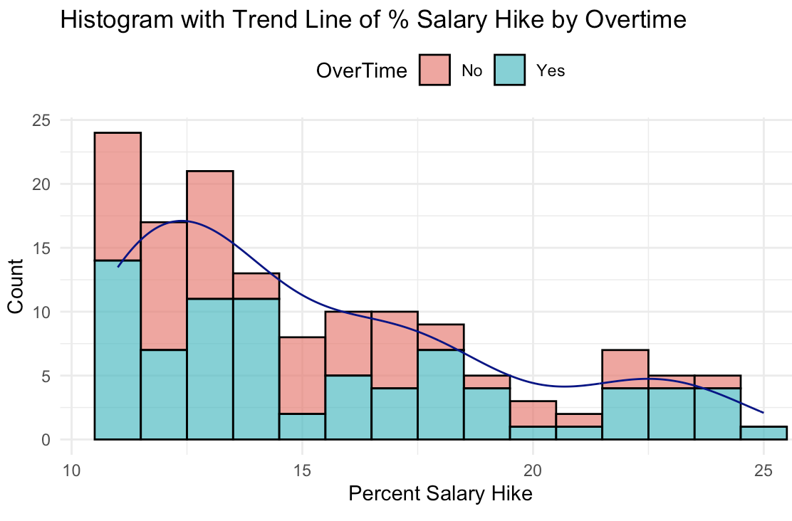
Attrition – Histogram of Percent Salary Hike
Notes:
This is a histogram of percent salary hike, with each bar being split and shaded by if the employee(s) were working over time. The overall percent salary hike (without the split) seems to be right skewed generally, but the shape of the line/trend seems to imply that it may be multimodal.

Slide 24
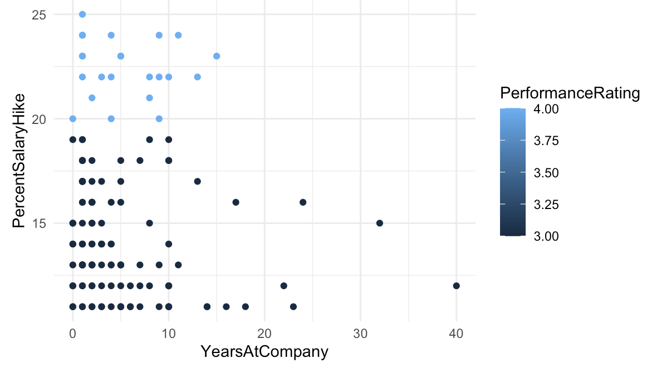
Attrition – Salary Hike and Years at Company
Notes:
This plot takes a look at Years at Company and Percent salary hike. Those with a higher performance rating seem to have a higher percent salary hike. For a Percent salary hike less than 20%, it seems like the performance rating is under 4, and trends around the 3 rating.
There is not a clear trend to confirm that more years at the company → higher percentage salary hike.

Slide 25
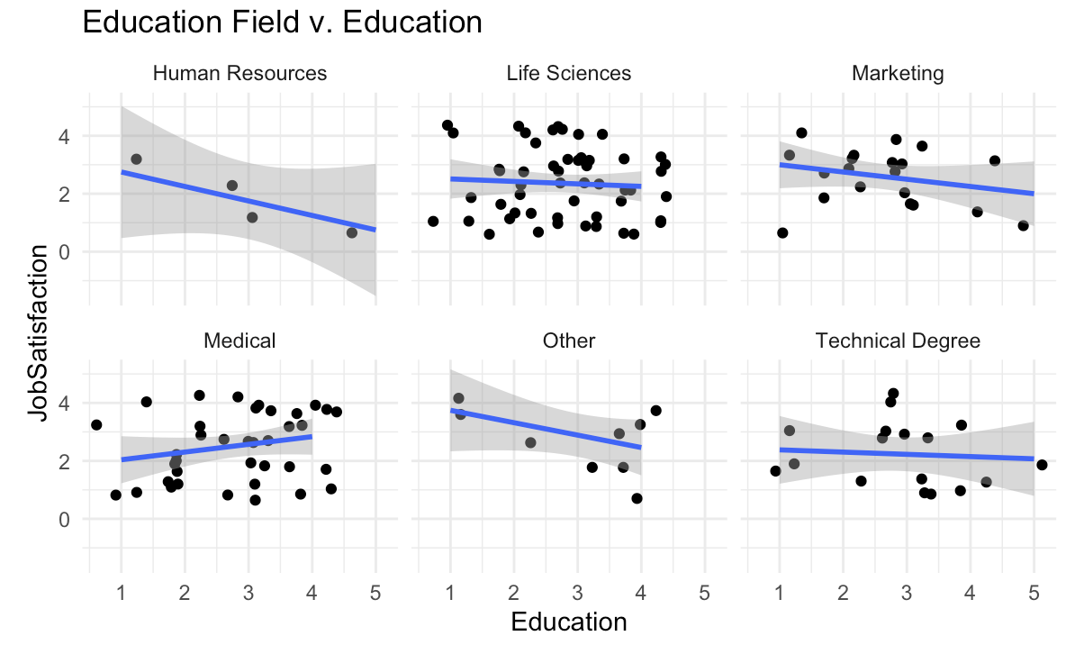
Attrition – Education and Job Satisfaction Categorized by Education Field
Notes:
This plot looks at the relationship between Job Satisfaction based on Education categorized by education field. Most education fields seem to have a negative correlation between job satisfaction and years of education, except for the Medical field. The medical field is the only field where as education increases, the job satifaction also seems to increase.

Slide 26
Building a Linear Regression Model to Predict Salary
Notes:
It was called “Monthly Income” in the data set.

Slide 27
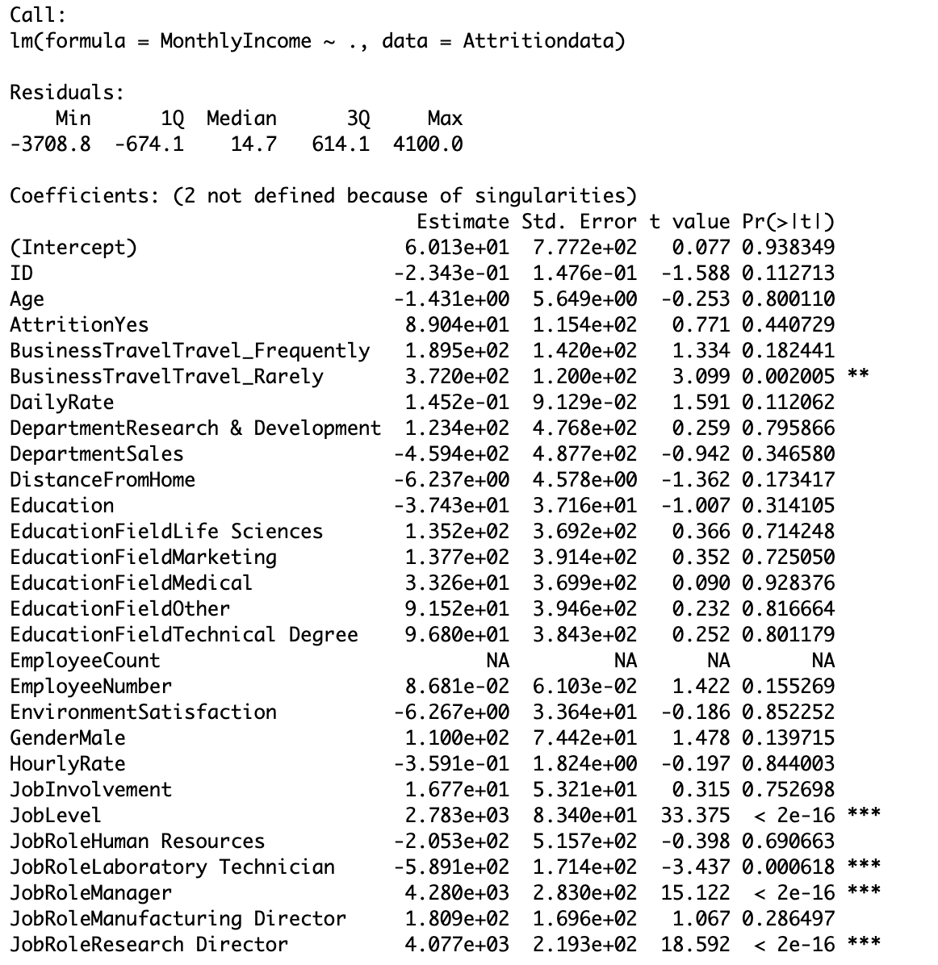
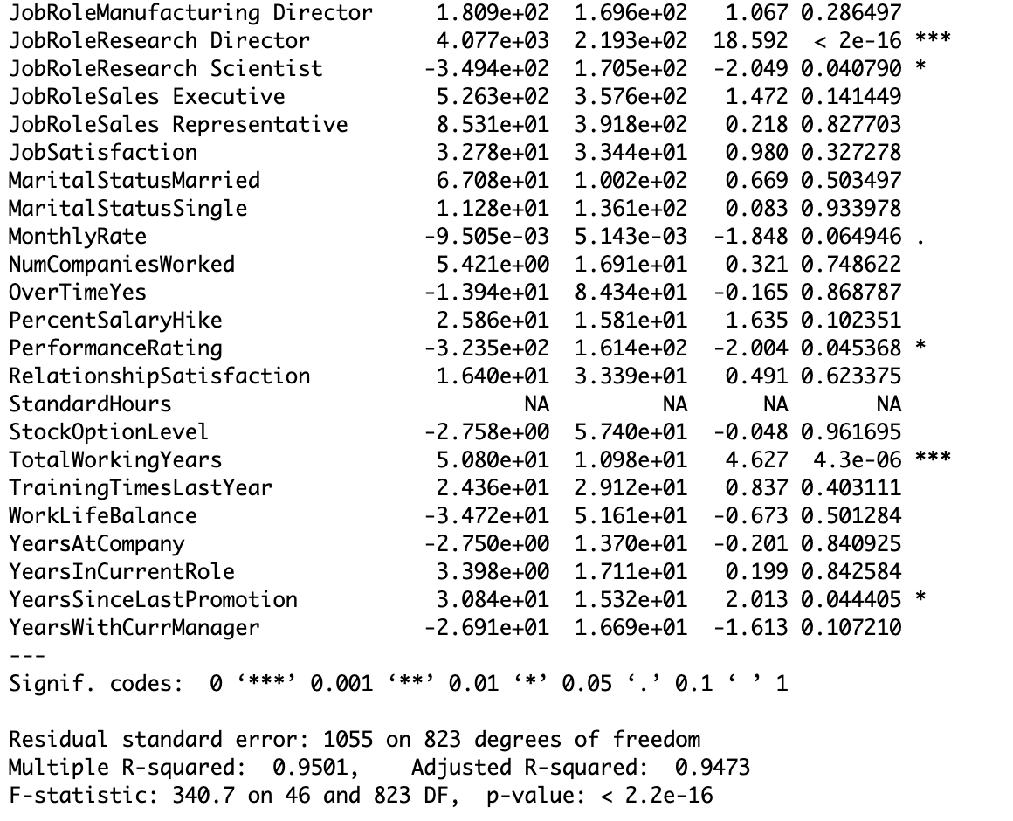
Model 1: Fitting a Model with All Predictors
Notes:
Looking at this summary of model 1 output, it indicates that the statistically significant p values are Business Travel, JobLevel, Job Role, Performance rating, Total working Years, and Years since last promotion. The F-statistic tests the overall significance of the model. The F-statistic is 340.7 with a very small p-value (< 2.2e-16), suggests that at least one predictor variable is significantly related to Monthly Income.There are two coefficients not defined because of singularities. This might indicate multicollinearity, where two or more predictor variables are highly correlated.

Slide 28
Model 2: Fitting a Linear Regression Model with Select Predictor
Selected Predictors:
Number of Companies Worked
Age
Gender
Marital Status
Job Involvement
Job Role
Distance From Home
Job Level
Education
Notes:
These select predictors were chosen because of the insights from the EDA. I thought they were significant predictors

Slide 29
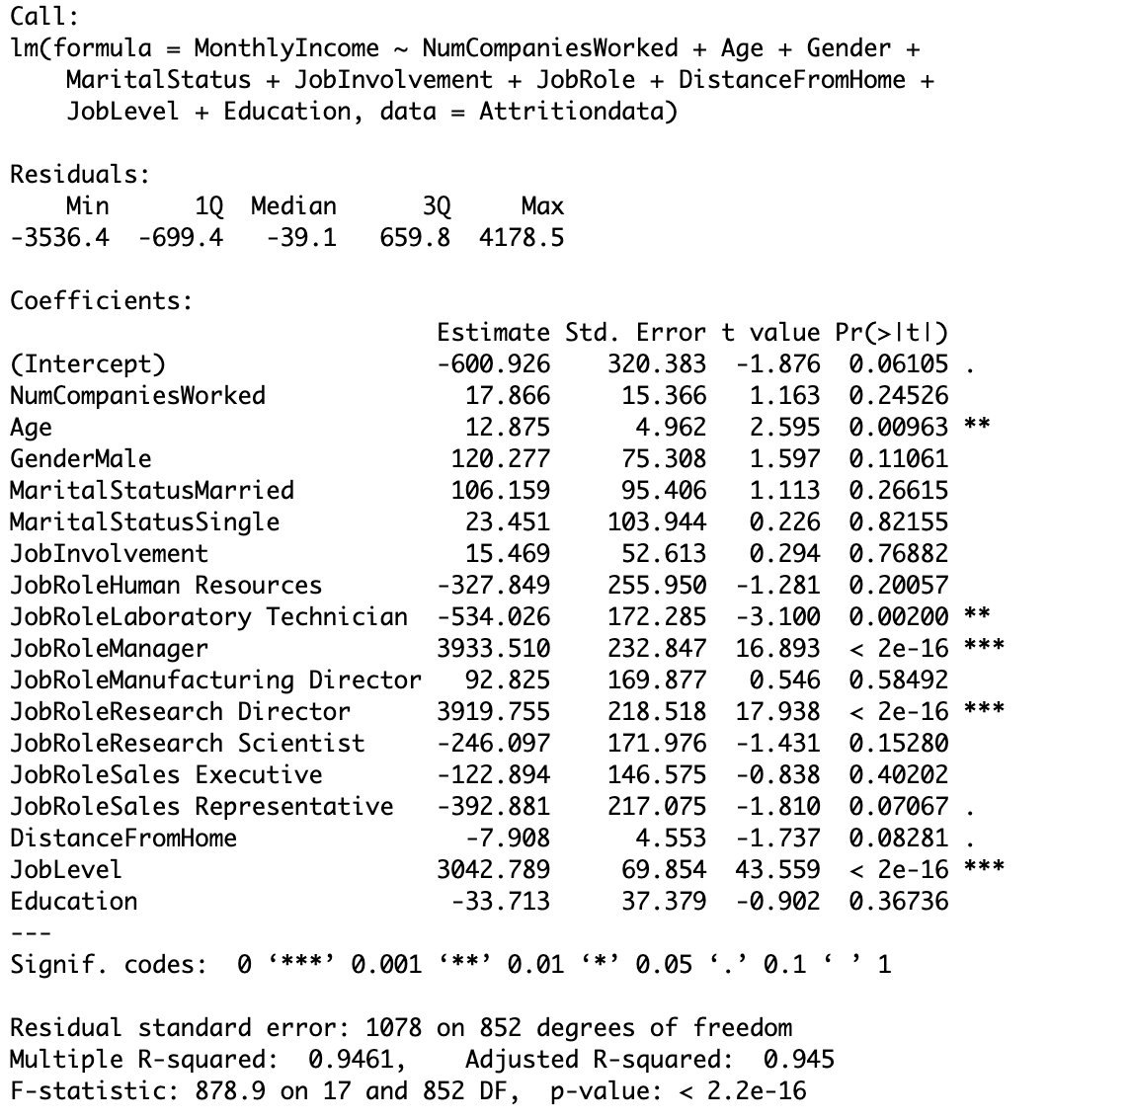
Model 2 Summary Stats
Notes:
The coefficient for JobLevel is 3042.789. This suggests that, on average, an increase of one unit in JobLevel is associated with an increase of $3042.789 in MonthlyIncome.Likewise, Age has a coefficient of 12.875 indicating that a year increase in age, results in $12.88 additional monthly income, holding all other variables constant. Males have a coefficient of 120, indicating that holding all other variables constant, males make an additional $120 compared to women monthly. The coefficient for distance from home has a. -7.908, which indicates each additional mile away from home may result in a monthly salary decrease by -$7.
The statistically significant p values (<.10) are Age, certain Job Roles – like Laboratory Technician, Manager, and Research director, Job Level;
Overall, Model 2 appears to have a high R-squared value, indicating a good fit to the data. Many predictors are statistically significant, suggesting they contribute to determining Monthly Income

Slide 30
Comparing Model 1 and Model 2 Process
Data was split 80/20 – for training and testing
Ran both model 1 and 2 to predict Monthly Income on the testing set
Cross Validation Process with 1000 iterations where MSPE and RMSE are calculated for both models
Summary Statistics of mean MSPE and mean RMSE for both models

Slide 31
Comparing Model 1 and Model 2 Summary Stats
 | Mean MSPE | Mean RMSE | AIC
Model 1 | 1196649 | $1,091.936 | 11699.08
Model 2 | 1194877 | $1,091.156 | 11698.73
Notes:
Model 2 is the better fit as it has a lower mean RMSE and lower mean MSPE, and lowest AIC
MSPE – mean square predictive error
RMSE – Root mean square error (aka sqr root of mspe)

Slide 32
KNN Model to Determine Attrition
Notes:
KNN stands for K Nearest Neighbors.

Slide 33
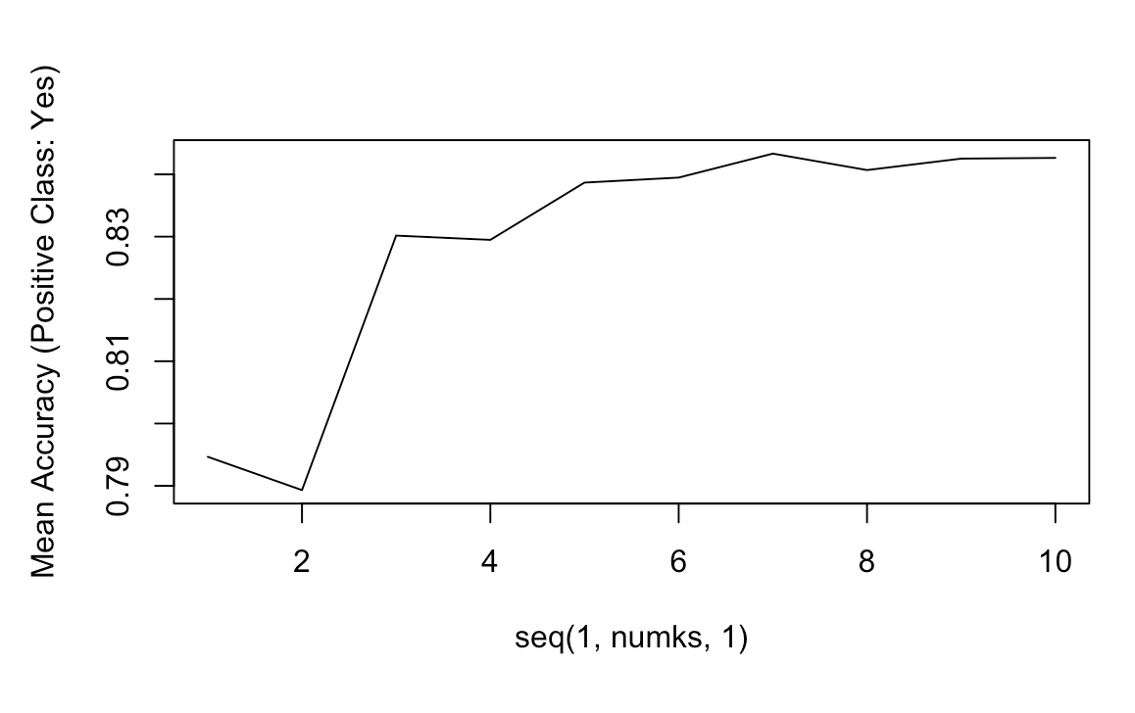
KNN Model 1 with All Predictors
The best K is k = 7

Slide 34
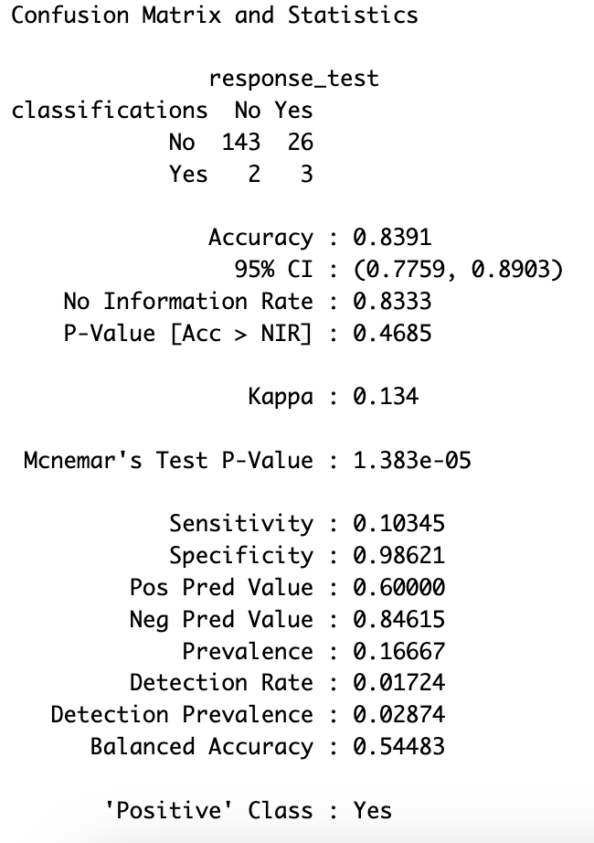
KNN Model 1 with All Predictors
Initial Average Confusion Matrix
The overall accuracy is 83.91%, but sensitivity (True Positive Rate) is low (10.35%).
The model is better at correctly predicting the majority class ("No") but struggles with the minority class ("Yes").
Notes:
The knn model ran through a loop of 100 iterations. The data was split 80/20 - 80% for training and 20% for testing.
Sensitivity (True Positive Rate): 10.345%
The proportion of actual positives correctly predicted.
Specificity (True Negative Rate): 98.62%
The proportion of actual negatives correctly predicted.
Positive Predictive Value (Precision): 60%
The proportion of predicted positives that are true positives.
Negative Predictive Value: 84.62%
The proportion of predicted negatives that are true negatives.
Prevalence: 0.16667
The proportion of actual positives in the dataset.

Slide 35
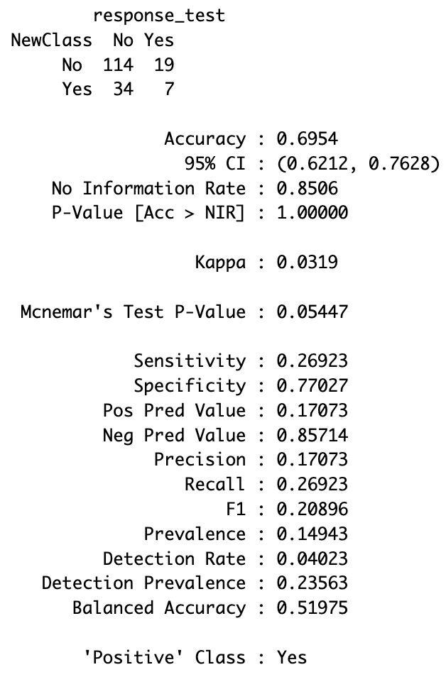
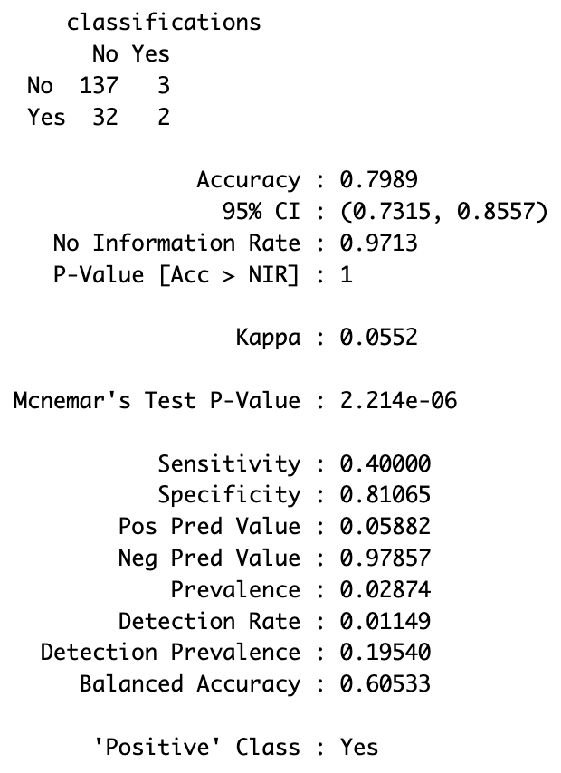
KNN Model 1 with All Predictors k = 7 along with threshold change
Without the threshold change
With the threshold change
Accuracy and sensitivity are better for the original KNN k = 7 model with all predictors without the threshold change
Notes:
Similar to before, the loop ran for 100 iterations, but k was set to 7 when it came to knn. There are 2 confusion matrices. We have one, without the threshold changes, and on the right, we have with a threshold change. The accuracy went down with the threshold change, while sensitivity reduced by a lot, and specificity reduced by ~10%. The positive predictive value increased by 9%, and the negative pred value reduced by 14%.
The new threshold has a lower accuracy compared to the original kNN classification.
Sensitivity is significantly lower for the new threshold, indicating that fewer true positives are captured.
Specificity is slightly lower for the new threshold, indicating a decrease in correctly identified true negatives.
Precision is lower for the new threshold, reflecting a decrease in the accuracy of positive predictions.
The original kNN classification has a higher accuracy and sensitivity compared to the new threshold.
However, precision is low for the original kNN classification, suggesting a high rate of false positives.

Slide 36
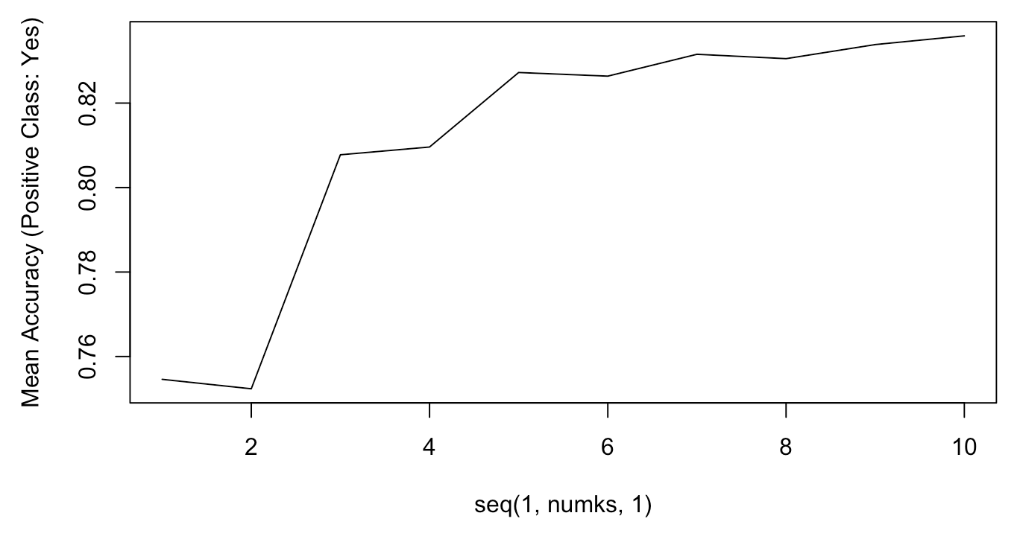
KNN Model 2 with Select Predictors
Selected Predictors:
Gender
Department
Job Satisfaction
Distance From Home
Monthly Income
Job Level
Age
Over Time
Percent Salary Hike
Performance Rating
Education
The best K is k = 10
Notes:
Selected Predictors chosen after doing EDA.

Slide 37
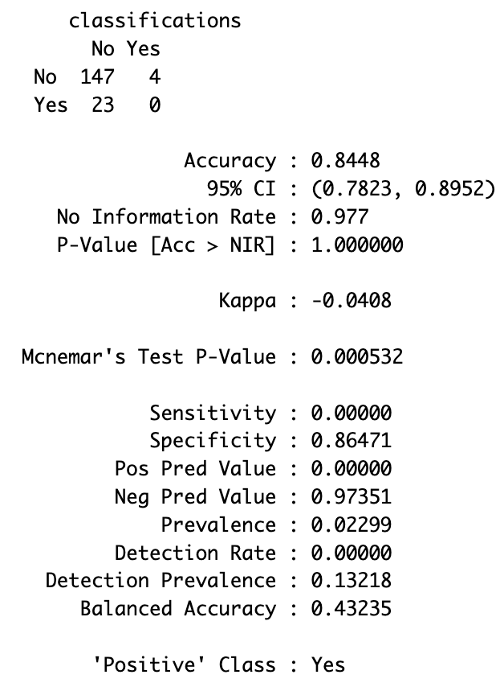
KNN Model 2 with Select Predictors k = 10 without threshold change
Confusion Matrix for k = 10
For k = 10, the overall accuracy is 84.48%, with a sensitivity of 0% and specificity of 86.47%.
This model’s performance is poor. The best KNN Model is k = 7 without the threshold change.
Notes:
We see that the best k is k = 10. For the k – 10 confusion matrix: This model's performance is notably poor, with zero sensitivity, meaning it failed to correctly identify any positive instances. The specificity and negative predictive value are relatively high, but the lack of sensitivity indicates a serious limitation in identifying instances of the positive class. This suggests that the model might need further refinement or a different approach to address the imbalance and improve its ability to correctly classify positive instances.

Slide 38
Naïve Bayes Model

Slide 39
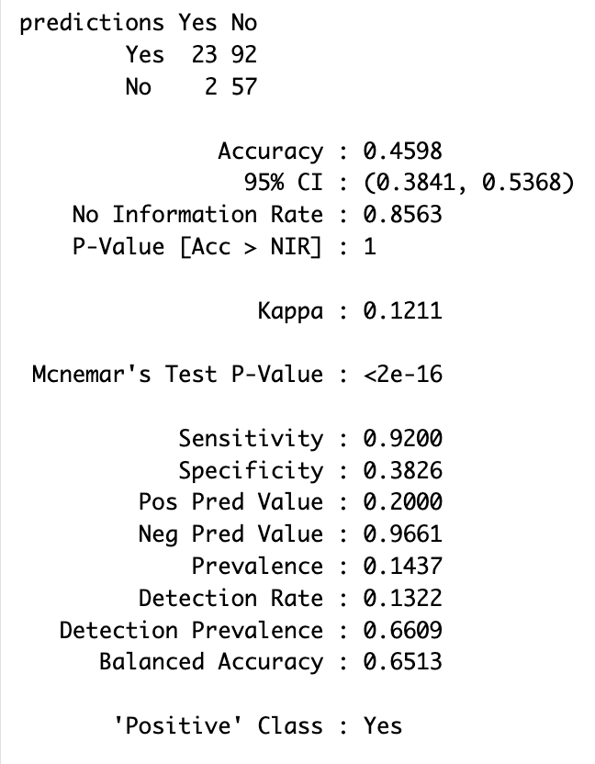
Naïve Bayes – Model 1 with All Predictors
Similar to the previous models, 80/20 split, and a loop with 100 iterations
Sensitivity is 92% (actual attrition cases correctly identified)
This model has a low accuracy of 45.98%, and has imbalanced performance with high sensitivity and low specificity.
Positive predictive value is relatively low at 20% - indicating that when positive instance is predicted, only 20% chance of being correct.
Notes:
Given all the predictors, the sensitivity rate of the model is the percentage of actual attrition cases correctly identified. It measures the model's ability to capture employees who are truly at risk of attrition among all employees who actually attrite. This model shows imbalanced performance with high sensitivity (high attrition) but low specificity. It performs well in identifying actual positive instances (attrition) but struggles to correctly identify negative instances(no attrition). The positive predictive value is relatively low, indicating that when it predicts a positive instance, it has a 20% chance of being correct.

Slide 40
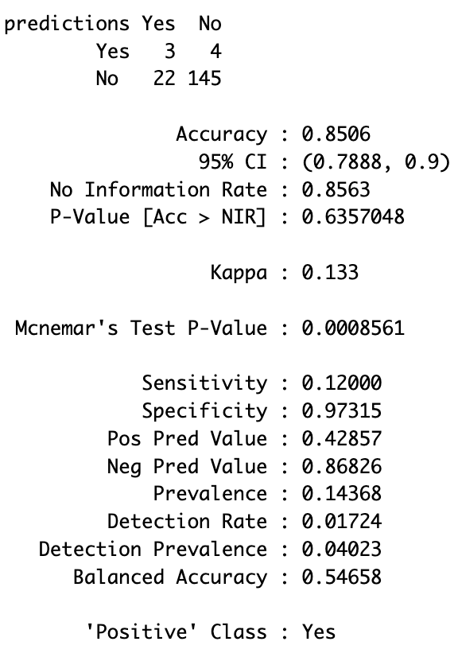
Naïve Bayes – Model 2 with Select Predictors
Sensitivity is 12% (actual attrition cases correctly identified)
This model has a higher accuracy of 85.06%, and has imbalanced performance with low sensitivity and high specificity.
Positive predictive value is ok at 42.86% - indicating that when positive instance is predicted, only 42.86% chance of being correct.
This is the better Naïve Bayes Model
Notes:
Sensitivity is 12%; 12% of actual attrition cases are correctly identified by the model. This suggests that the model may not be very effective at capturing employees who are truly at risk of attrition.
This model has a higher accuracy of 85.06%, and has imbalanced performance with low sensitivity and high specificity. However, accuracy can be misleading, especially in imbalanced datasets where one class (e.g., "No attrition") dominates. In this case, accuracy is not the best metric to evaluate the model's performance. Positive predictive value (PPV) is at 42.86%. This indicates that when the model predicts attrition, there's a 42.86% chance that the prediction is correct. It reflects the precision of the model in identifying true positive cases among all instances predicted as positive. The low prevalence (the proportion of actual positive cases in the dataset) of attrition, is 14.37%. This low prevalence contributes to the imbalanced nature of the performance metrics.

Slide 41
Which is the best model to predict Attrition?
KNN or Naïve Bayes?

Slide 42
KNN v. Naïve Bayes
Notes:
We have the KNN best model on the left and the Naïve bayes model on the right.
Naive Bayes has a higher accuracy (85.06%) compared to KNN (79.89%). However, accuracy alone may not be the most informative metric, especially in imbalanced datasets.
KNN has a higher sensitivity (40.00%) compared to Naive Bayes (12.00%). Sensitivity is crucial when identifying cases of attrition, as it represents the proportion of true positive cases among all actual positive cases.
Naive Bayes has higher specificity (97.32%) compared to KNN (81.07%). Specificity is important when minimizing false positives, but it's essential to balance it with sensitivity.
Naïve Bayes has a higher positive predictive value (precision) at 42.86%, while KNN has a lower precision at 5.88%. Precision indicates the accuracy of positive predictions.

Slide 43
KNN v. Naïve Bayes
Notes:
We have the KNN best model on the left and the Naïve bayes model on the right.
I think the Naïve Bayes is the better predictor of attrition – given the high positive prediction value, accuracy, and narrower confidence interval.
On the Attrition Test Dataset, 11 people have been predicted to leave of the 300.

Slide 44
rkarthikeyan@smu.edu
Thank You
Check out a link to my Attrition Shiny App!
https://renu-karthikeyan.shinyapps.io/Attempt2/
Notes:
R: This concludes this presentation. Thank you for your time and I look forward to empowering FritoLay with data-driven wisdom. I created a shiny app to visualize and notice insights regarding the attrition data. Please feel free to look into the link provided. If you have any questions, please feel free to reach out to me, my email is on the screen. Thank you!

